Slide 1
PLAN MANAGEMENT ADVISORY GROUP
October 20, 2016

Slide 2
WELCOME AND AGENDA REVIEW
BRENT BARNHART, CHAIR
PLAN MANAGEMENT ADVISORY GROUP

Slide 3
AGENDA
AGENDA
Plan Management and Delivery System Reform Advisory Group
Meeting and Webinar
Thursday, October 20, 2016, 10:00 a.m. to 12:00 p.m.
Webinar link: https://attendee.gotowebinar.com/rt/6132192224704601089
October Agenda Items Suggested Time
I. Welcome and Agenda Review 10:00 - 10:05 (5 min.)
II. Open Enrollment 4 10:05 – 10:35 (30 min.)
III. Introduction to 2018 Certification 10:35 – 11:05 (30 min.)
IV. Benefits Work Group 2018 Update 11:05 – 11:30 (25 min.)
V. Open Forum 11:30 – 11:50 (20 min.)
VI. Wrap-Up and Next Steps 11:50 – 12:00 (10 min.)

Slide 4
OPEN ENROLLMENT 4
DREW KYLER, BRANCH CHIEF
COVERED CALIFORNIA OUTREACH AND SALES

Slide 5
Covered California: Open Enrollment 4
From 2013 to 2015, nearly 3.2 million Californians have gained health insurance.
In raw numbers, California’s enrollment of nearly 3.2 million into insurance coverage is more than the next three states combined.
This helped California cut its uninsured rate in half, from 17.2 percent to 8.6 percent.
The 8.6 percent decrease is the largest of any state in the nation.
92 percent of Californian’s have at least 3 plans to choose from. Every Californian has more than one plan to choose from.

Slide 6
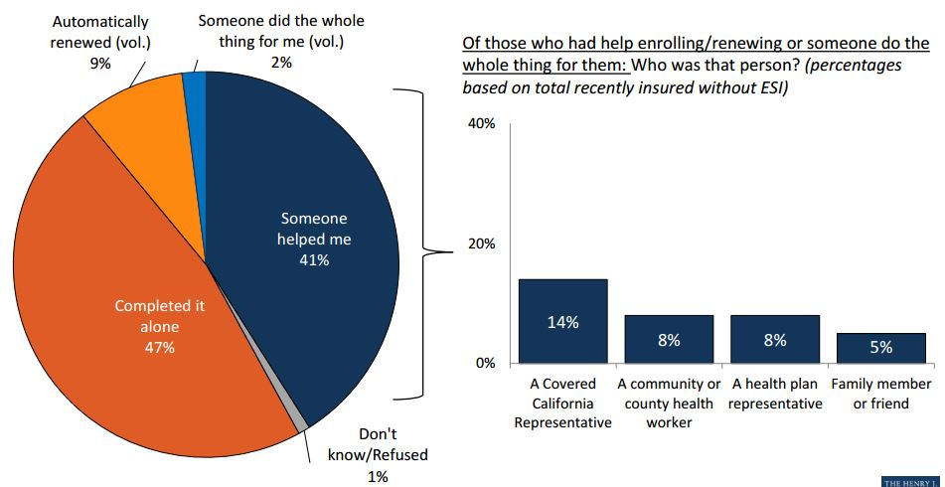
Covered California: Open Enrollment 4
Many have received in person assistance with enrollment, and of those, most were assisted by a Covered California enroller
SOURCE: Kaiser Family Foundation California Longitudinal Panel Surveys

Slide 7
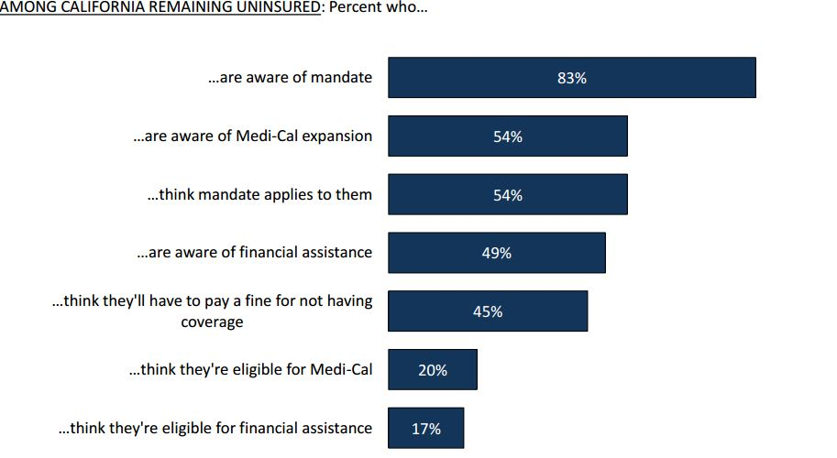
Covered California: Open Enrollment 4
There is still work to do! Among the remaining uninsured, awareness of the benefits of the ACA varies. Here is the percentage who:
SOURCE: Kaiser Family Foundation California Longitudinal Panel Surveys

Slide 8
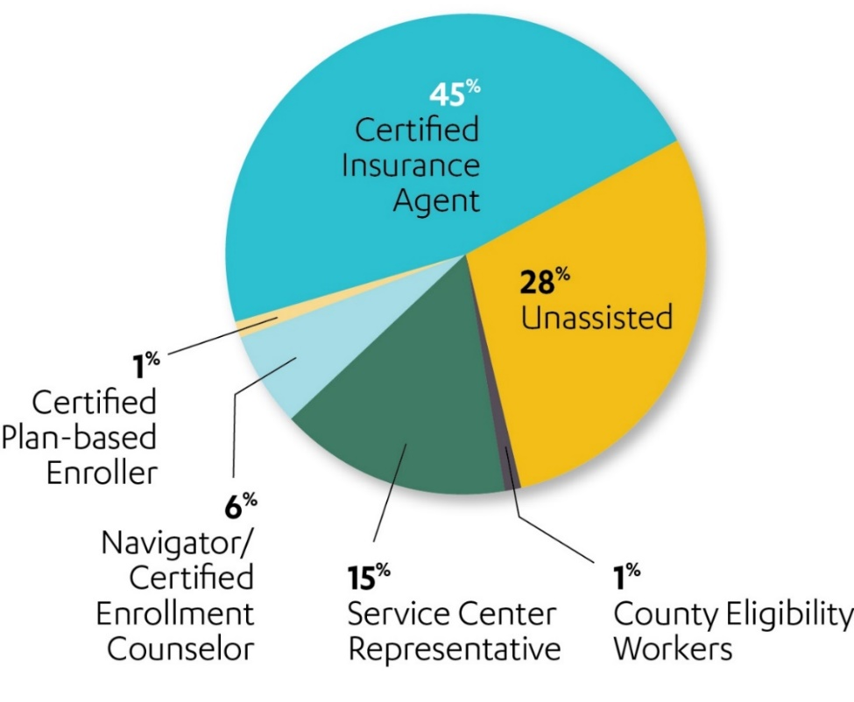

OUTREACH AND SALES:
ENROLLMENT WORKFORCE
14,204 Certified Insurance Agents
2,406 Certified Application Counselors
2,002 Navigator/Certified Enrollment Counselors
1,215 Plan-Based Enrollers
19,827 Total
Storefronts
582 Approved Storefronts
Outreach
53% enrolled with Certified Partner

Slide 9

OUTREACH AND SALES: OPEN ENROLLMENT 4 STRATEGY PLAN
Facilitated “AMPED UP!” statewide kick off meetings
11 Meetings in September 2016
9 Cities: Oakland, Redding, Fresno, San Diego, Rancho Cucamonga, Garden Grove (2) , Santa Barbara, Los Angeles (2), and Sacramento
100+ attendees at each of the meeting (except Redding- 40 attendees) = 1,000+ attendees overall
Certified Enrollment Representatives: Certified Insurance Agents and Certified Application/Enrollment Counselors; and
Local Partners: Health/Dental/Vision Plan Representatives, County Medi-Cal Representatives, Elected Officials, and Community Partners
Trained our Sales Partners with enrollment strategies and how to outreach and educate their communities to enroll in Covered California.

Slide 10
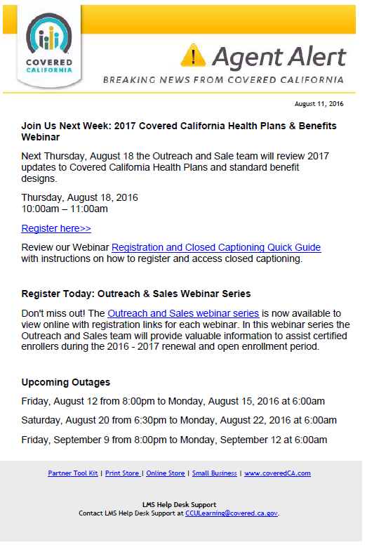
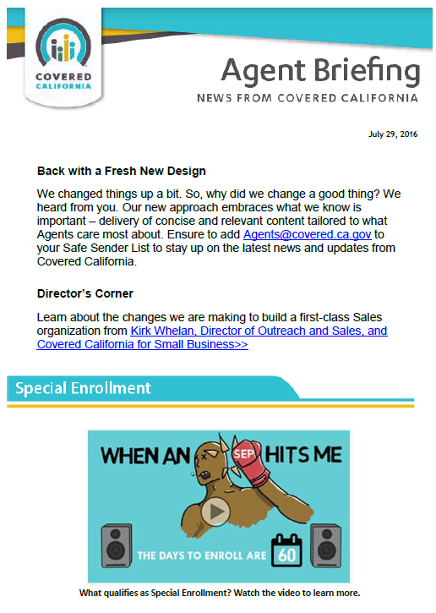
OUTREACH AND SALES: OPEN ENROLLMENT 4 STRATEGY PLAN
Email News Briefs and Alerts highlighting the latest news to our Sales Partners
Biweekly distribution to all Sales Partners
Updates on Application Portal Releases of new functionalities
Reminders for administrative tasks – certification and recertification, trainings, etc.
Calendars for Service Center Hours and Outages
Sign-up: OutreachandSales@covered.ca.gov

Slide 11
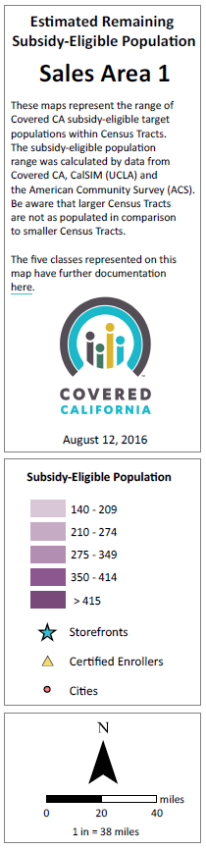
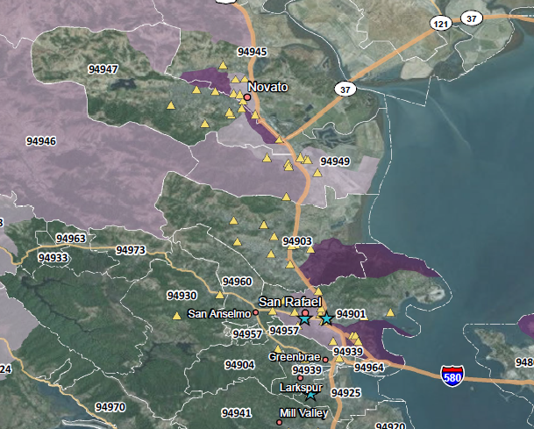
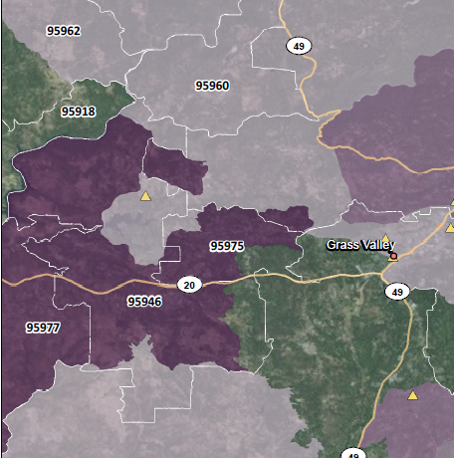
OUTREACH AND SALES: OPEN ENROLLMENT 4 STRATEGY PLAN
Update Tool Kits for our Sales Partner
2017 Health and Dental Plans Tool Kit
2017 Plan Rates and Regional Data Sheets
Renewal (Job Aids and Sample Notices)
2017 PCP Matching (Quick Guide)
2016 Subsidy-Eligible Maps
New Printable Materials for consumers (Open Enrollment Guide, Paper Calculator, brochures, etc.)

Slide 12



OUTREACH AND SALES: OPPORTUNITIES TO ENGAGE
Covered California Website: “Find Local Help to Enroll”
Covered California Storefront Program
Covered California Events Web Page
Covered California Sales Tools
Covered California Collateral Materials

Slide 13
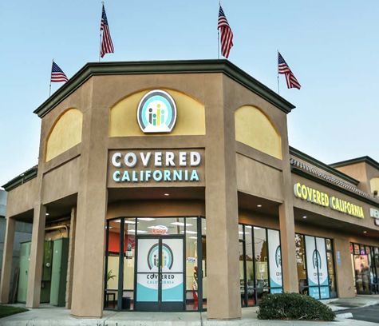
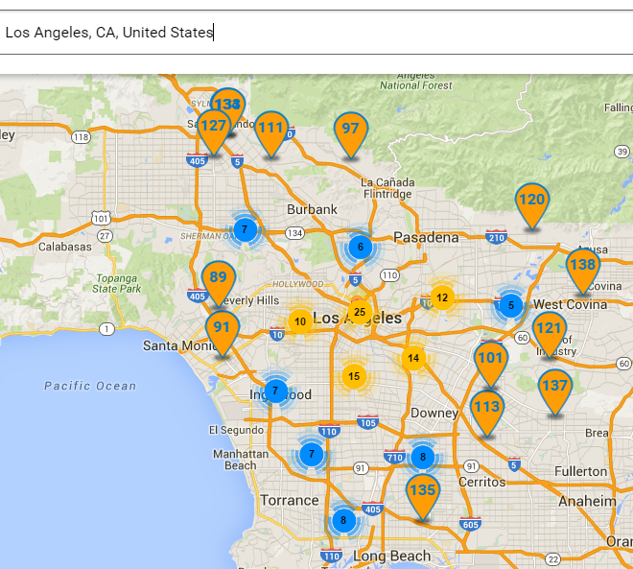

OUTREACH AND SALES: STOREFRONT PROGRAM
582 Storefronts
Certified Insurance Agent or Certified Enrollment Entity offices
Open year round to provide in-person enrollment assistance
Developing more in hot zones where the uninsured eligible remains…
Storefront Finder Tool on http://www.coveredca.com/get-help/local/
Notes:
35 new storefronts since our last meeting
547 in July 2016

Slide 14
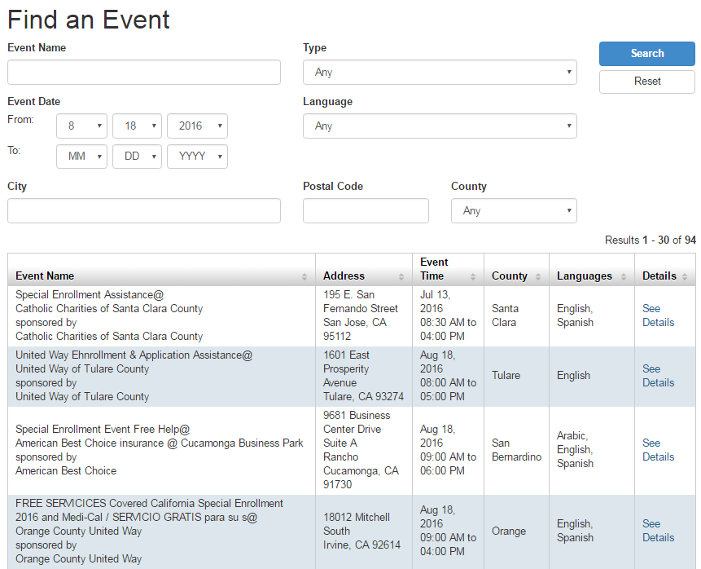
OUTREACH AND SALES: CURRENT EVENTS
156 current events posted
Timeframe: 10/3/16 – 1/31/17
By: Certified Insurance Agents or Certified Enrollment Entity offices hosting or participating
Find an Event: www.coveredca.com/get-help/local/events/
Count of Events
Past Events (Pre-OE3) 12/4/2014 thru 10/31/2015 | OE3 Past Events 11/01/2015 thru 1/31/2016 | OE3 Current Month and Future Events 2/1/2016 and beyond
4,533 | 3,124 | 1,415

Slide 15
OUTREACH AND SALES: PARTNERSHIPS
Covered California
Community Colleges
DMV
Insurance Agencies
Local County Health Agencies
Local Health, Dental, and Vision Carriers
Local Malls and Stores
Federal Support
Healthy Campus Challenge
Naturalization/Citizenship Ceremonies
Westfield Malls
Ralph Stores
Lyft

Slide 16
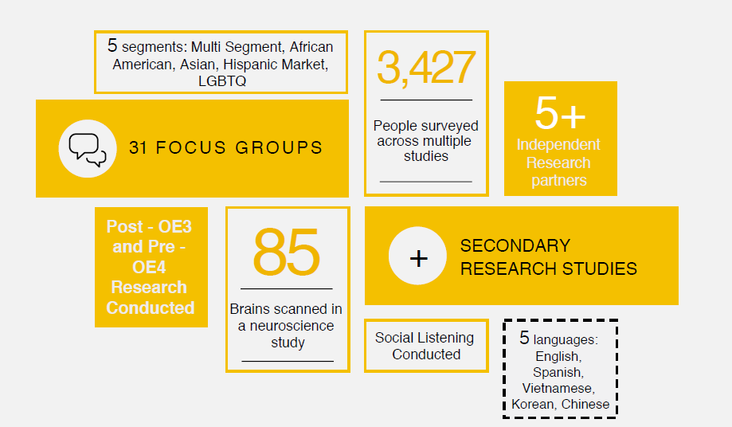
MARKETING: OE4 RESEARCH OVERVIEW

Slide 17
MARKETING: OE4 RESEARCH –KEY LEARNINGS
To help inform OE4 creative and planning, Covered California conducted qualitative and quantitative research with uninsured Californians in the Multi-Segment, African American, Hispanic, Asian and LGBTQ communities.
What we learned across all segments:
The new brand campaign, “It’s life care.” which emotionally conveys the value of coverage, tested very well.
Remaining uninsured are harder to convince and they have found ways to cope
Awareness of Covered California is good, but there’s still confusion about what Covered California is, what we offer. Audiences want specifics.
Affordability is, by far, offered as the #1 barrier
Consumers feel overwhelmed. Health insurance is complicated and they face difficulties with the shopping and enrollment process.
Some nuances by segments emerged for Asian and LGBTQ communities. While African American and Latino segments were consistent with Multi-Segment group.
Notes:
Affordability is, by far, offered as the #1 barrier regardless of ethnicity, language, income, education, subsidy eligibility, etc. (including not just the monthly premium but the costs associated with using insurance).
Awareness of Covered California is good, but there’s still confusion about what Covered California is, what we offer and health insurance generally (#2 barrier). Consumers desire specific information in consumable amounts (not too little, not too much), such as what health plans are offered, what preventive care is included, and how much insurance would cost.
Remaining uninsured are harder to convince. They want insurance, but enrollment difficulties + unaffordable = resistance. They have found ways to cope including home remedies, corner clinics, services online or in other countries, and “healthy living,” and they don’t want to deal with the complexities of health insurance.
The top positive motivators were lower cost, preventive care, dental and more/better/consistent coverage. The top negative motivators were fear of paying out of pocket, financial ruin and concern about letting an illness go unchecked. The tax penalty and deadlines put them on the defensive.
The new brand campaign, “It’s life care.” which emotionally conveys the value of coverage, tested very well.
Nuances by segment emerged and are being incorporated.

Slide 18
MARKETING: TOP PERFORMING MESSAGE TOPICS
The following are the top performing message topics that we will work into our creative across segments and channels:
Preventive with specific examples
Availability of dental coverage
Health insurance at a lower cost
Choice of plans including specific names of QHP’s
Free expert help
Notes:
Preventive with specific examples
Preventive care, like flu shots, annual check-ups, cancer screenings and diabetes screenings, are included in every health plan offered through Covered California, at no additional cost.
Availability of dental coverage
You can add dental coverage to your health insurance purchased through Covered California.
Health insurance at a lower cost
At Covered California, you could get health insurance at a lower cost.
At Covered California, you could get financial help to pay for health insurance.
Find out if you can get health insurance for a lower cost in just a few questions.
Choice of plans including specific names of QHP’s
With Covered California, health insurance companies compete to offer you the right plan for the best price.
No matter how much money you make, at Covered California there's a health plan for you.
We can help you choose between different insurance companies we offer, like Kaiser, Blue Shield, Anthem and HealthNet.
Free expert help
Covered California can help you find out if you qualify for monthly health insurance payments at a lower cost.
Everyone’s health needs are unique. Covered California’s knowledgeable experts can help you choose the health insurance plan that’s best for you.
Get free help from our health insurance experts.

Slide 19

Marketing: Applying the research learnings to OE 4 creative
To address the need for more specific information we are doing the following across segments and media channels:
1) Feature QHP logos to show that we offer a choice of quality brand name health plans.

Slide 20
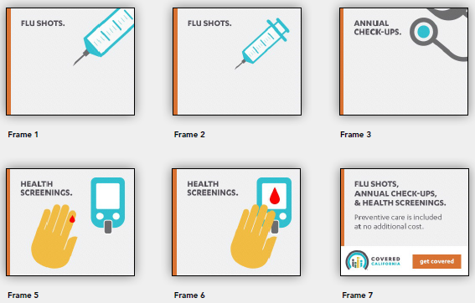
MARKETING: APPLYING THE RESEARCH LEARNINGS TO OE 4 CREATIVE
2) Provide details about what free preventive services are included in all health plans purchased through Covered California.

Slide 21


MARKETING: MEDIA PLAN- TARGET AUDIENCE
Retention & Renewal
All current Covered California members
Acquisition (Open Enrollment )
Remaining uninsured Californians
Subsidy eligible (500k-615k)**
Non-subsidy eligible (460k)**
Age: Media target A25-54
Income: $50k-$130k
Segments:
In-Language
Asian*
MULTI-SEGMENT
English Speaking Latinos
African Americans
English Speaking Asians
General Market
Millennials
LGBT
In-Language
Latino
*Member communications & Social Media
LGBT
African American
In-culture
**Price Waterhouse Coopers Covered California 2016-2022 Market Analysis and Planning report
20
*Asian In-language: Primary – Chinese, Vietnamese, Korean; Secondary – Filipino (Tagalog), Hmong, Laotian, Cambodian

Slide 22
MARKETING: MEDIA PLAN- CAMPAIGN TIMING AND ELECTION CONSIDERATIONS
Renewal Period
Begins October 2016 – December 15, 2016
Open Enrollment Period
November 1, 2016 – January 31, 2017
Most campaign efforts will begin after the 2016 Presidential election (Nov. 14) due to expected high ad spending across all channels contributing to inventory pressure

Slide 23
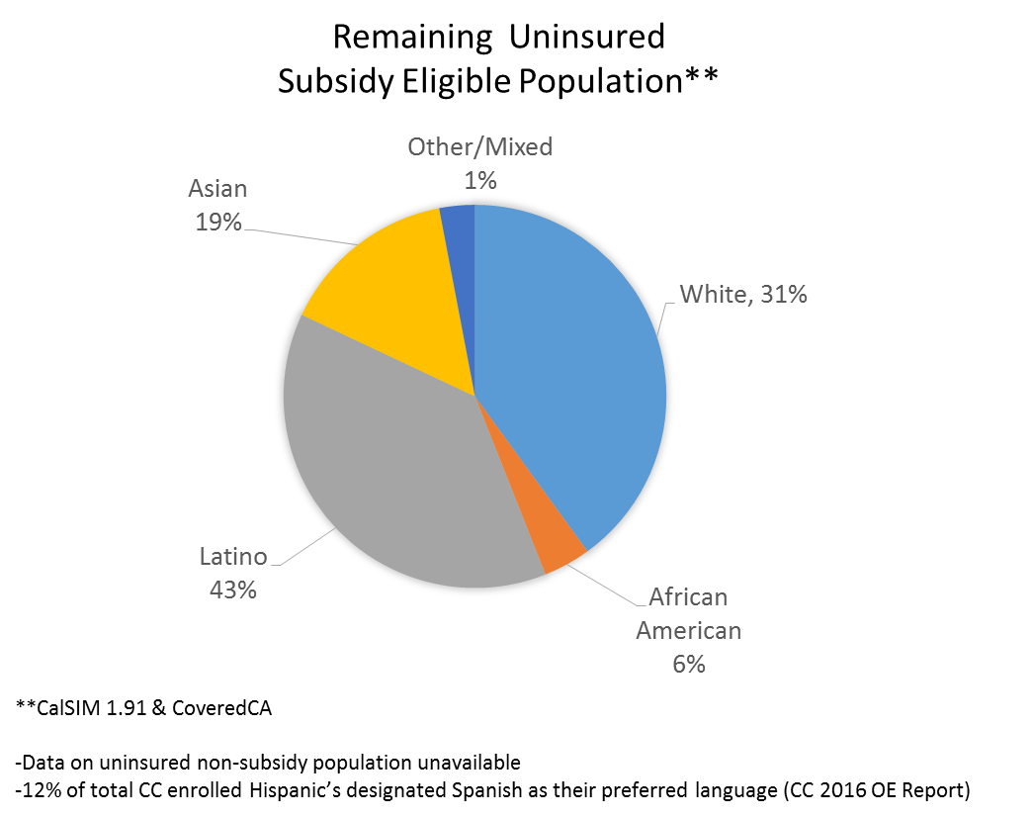
MARKETING: MEDIA PLAN- TARGET MARKETS & SEGMENTS
TIER 1 LOS ANGELES
TIER 2 SAN FRANCISCO SACRAMENTO FRESNO SAN DIEGO
TIER 3 BAKERSFIELD (tier 1 for Hispanic segment) PALM SPRINGS MONTEREY-SALINAS SANTA BARBARA EUREKA CHICO-REDDING

Slide 24
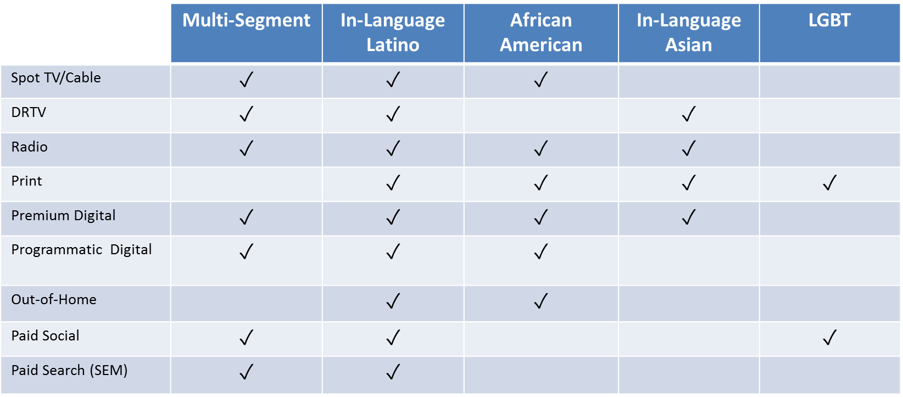
MARKETING: MEDIA PLAN- PAID MEDIA CHANNELS BY SEGMENT

Slide 25
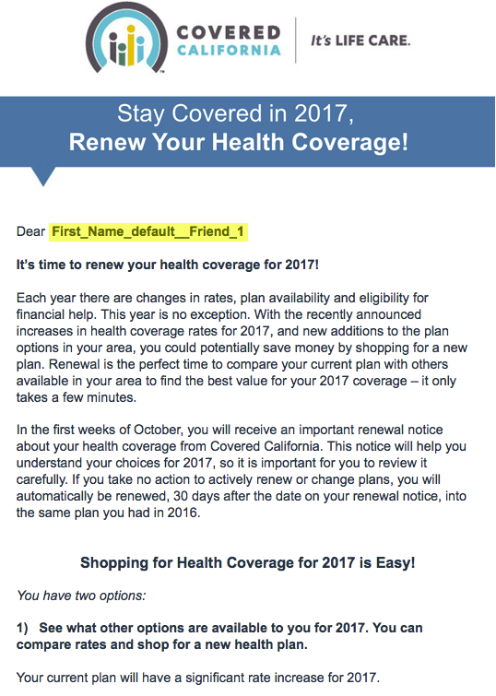
MARKETING: RETENTION AND RENEWAL
Segment member base into message specific groups to address 2017 plan year changes i.e. rate increases, carrier exits, carrier expansion
Primary message will be “Shop and Compare plan options to be sure you have the plan that provides you the best value in 2017”
Messages will be focused around key dates and specific calls to action

Slide 26
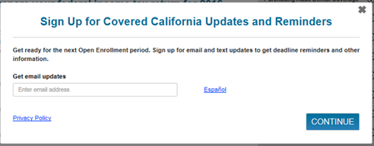
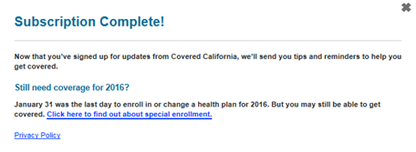
MARKETING: WEBSITE ENHANCEMENTS
Email subscription form
Mobile and Desktop version
Option to subscribe to CoveredCA email updates
Notes:
Lead Capture/Nurture
Based on whether someone is a new or returning visitor to coveredca.com, web visitors will be presented with a pop-up email subscription form that will give them the option to subscribe to CoveredCA.com for e-mail reminders regarding enrollment deadlines and other important information updates that will help consumers through the purchase funnel.
Visitors who chose not to subscribe with the new visitor pop-up form will be able to subscribe on return visits to coveredca.com by submitting their e-mail information through static subscription boxes that will be placed in the footer of coveredca.com.
Once subscribed, visitors will be placed into automated e-mail campaigns that will send (or suppress) content that is triggered based on the subscriber’s engagement with e-mail, online surveys, or other web based digital content.
Subscribers will have the opportunity to update their e-mail preferences or unsubscribe at any time by clicking on links in the footer of every e-mail that is sent to them.
2. Self-Enrollment Resource Page
Marketing is working with the Communications division to update self-help resources on a dedicated sub-page of coveredca.com that will speak directly to the needs of web visitors that are new to coveredca.com and are DIYers.
The content on this page will include high level summaries of the different stages of the application process, and offer streamlined copy, including tips, and video content illustrating how to move through each section of the online application as it will look on Nov 1, 2016.
The page content and side bar navigation of the self-help resources page will be updated as needed using weekly and bi-weekly analytics to insure that content is current and relevant to visitors based on content engagement levels.

Slide 27
INTRODUCTION TO 2018 CERTIFICATION
TAYLOR PRIESTLEY, CERTIFICATION PROGRAM MANAGER
PLAN MANAGEMENT DIVISION

Slide 28
Proposed 2018 QHP CERTIFICATION Milestones
Plan Management Advisory: Benefit Design & Certification Policy recommendation | January 2017
Release draft 2018 QHP & QDP Certification Applications | January 2017
January Board Meeting: discussion of benefit design & certification policy recommendation | January 2017
Draft application comment periods end | February 2017
Letters of Intent Accepted | February 2017
Final AV Calculator Released* | February
February Board Meeting: anticipated approval of 2018 Standard Benefit Plan Designs & Certification Policy | February 2017
Applicant Trainings (electronic submission software, SERFF submission and templates*) | February 2017
QHP & QDP Applications Open | ~March 1, 2017
QHP Application Responses (Individual and CCSB) Due | ~May 1, 2017
Evaluation of QHP Responses & Negotiation Prep | May - June 2017
QHP Negotiations | June 2017
QHP Preliminary Rates Announcement | July 2017
Regulatory Rate Review Begins (QHP Individual Marketplace) | July 2017
QDP Application Responses (Individual and CCSB) Due | ~April 1 or June 1, 2017
Evaluation of QDP Responses & Negotiation Prep | June – July 2017
QDP Negotiations | April or July 2017
CCSB QHP Rates Due | TBD
QDP Rates Announcement (no regulatory rate review) | August 1
Public posting of proposed rates | TBD
Public posting of final rates | TBD
*Final AV Calculator and final SERFF Templates availability dependent on CMS release
TBD = dependent on CCIIO rate filing timeline requirements

Slide 29
QHP Individual Marketplace Principles
PY 2018 Certification Application open to:
Issuers offering QHPs certified for 2017
Medi-Cal Managed Care Plans
Issuers newly licensed since May 2, 2016
Certification application will be shortened for issuers contracted 2017-2019 and will focus on review and approval of:
Contract compliance and performance review
Rates
Benefits
Networks
New products
Updates to performance targets and requirements if needed
There will not be a separate “recertification” application for these returning applicants.

Slide 30
QHP Covered California for Small Business Principles
PY 2018 Certification Application open to:
Issuers offering QHPs certified for 2017
Currently licensed issuers
Certification application will be shortened for issuers contracted 2017-2019 and will focus on review and approval of:
Contract compliance and performance review
Rates
Benefits
Networks
New products
Updates to performance targets and requirements if needed
There will not be a separate “recertification” application for these returning applicants.

Slide 31
QDP Individual & CCSB Marketplaces Principles
PY 2018 Certification Application open to:
Issuers offering QDPs certified for 2017
Issuers newly licensed since May 2, 2016
Certification application will be shortened for issuers contracted 2017-2019 and will focus on review and approval of:
Contract compliance and performance review
Rates
Benefits
Networks
New products
Updates to performance targets and requirements if needed
There will not be a separate “recertification” application for these returning applicants.

Slide 32
BENEFITS WORK GROUP 2018 UPDATE
LINDSAY PETERSEN, QUALITY AND NETWORKS SPECIALIST
PLAN MANAGEMENT DIVISION

Slide 33
STRATEGY FOR PATIENT-CENTERED BENEFIT PLAN DESIGNS
Organizational Goal
Covered California should have benefit designs that are standardized, promote access to care, and are easy for consumers to understand = PATIENT-CENTERED.
Principles
Multi-year progressive strategy with consideration for market dynamics: changes in benefits should be considered annually based on consumer experience related to access and cost
Adhere to principles of value-based insurance design by setting cost shares that consider cost and value while prioritizing primary care and frequently needed care.
Set fixed copays as much as possible; limit coinsurance to less frequently used benefits or services with high variability in cost as necessary to meet required actuarial values.
Apply a stair-step approach for setting member cost shares for a service across each metal level, e.g. a primary care visit is $35 in the Silver tier, $30 in Gold, $15 in Platinum
TRIPLE AIM
Improve health of populations
Reduce costs of health care
Improve consumer experience of care

Slide 34
2018 BENEFIT DESIGN WORK GROUP: STILL ADDRESSING
Covered California is still working with CCIO on how to use the 2018 AV calculator since inputs have changed. Modeling of different designs has been put on hold until the 10/31 meeting, possibly 11/14, since we want to ensure our current designs in the 2018 calculator are properly represented first.
2018 AV calculator parameter changes of note:
Maximum out-of-pocket (MOOP) limit: $7,350 (2.8%/$200 increase from 2017)
Silver 94 and Silver 87: $2,450 ($100 increase)
Silver 73: $5,850 ($150 increase)
Extended de minimis range for Bronze and Bronze HDHP plans: -2% / +5% AV
Must cover and pay for at least one major service before the deductible, other than preventive services
NOTE: Covered California’s Bronze currently covers first three non-preventive visits at copay amount; lab tests and rehabilitation/habilitation services are not subject to deductible
Major services that may be covered before the deductible: primary care, specialty visits, inpatient services, generic/preferred brand/specialty drugs, ED visits

Slide 35
2018 BENEFIT DESIGN WORK GROUP: STILL ADDRESSING
Bronze Modeling Options
Per feedback from sales and broker teams, consumers choose the Bronze plan because it is the lowest cost plan that meets the requirements to avoid a tax penalty. If consumers could afford a higher premium or anticipate utilizing services, they would purchase Silver.
Option 1: Only raising the deductible and MOOP to the maximum would result in an AV that is well under the 2017 AV (60.69 in draft AVC).
Option 2: Raise deductible and MOOP plus remove deductible from select services and/or lower copays.
Note: Lean toward keeping traditional AV limit of 62% (concern for possible rate increase and off Exchange impacts)
Silver 70: Modeling Options
AV is high in 2018 calculator (approximately 79%) but this may change once we refine inputs with CCIIO.
Examples of changes to move AV:
Keep medical deductible at $2,500 and change other cost shares to get within de minimis range
Add deductible to select services (possibly outpatient/exploring OOP; avoid emergency)

Slide 36
2018 BENEFIT DESIGN WORK GROUP: STILL ADDRESING
On the following topics more discussion is planned to answer additional questions.
Design cost tradeoffs to meet needed AV changes while upholding guiding principles considering administration/operations.
Pharmacy benefit coverage of vaccines
New Medi-Cal policy requires inclusion of adult immunizations, as defined by Advisory Committee on Immunization Practices, on formulary (as medical and pharmacy benefit) in order to expand access.
Pharmacy tiering
Anthem proposal to offer tiered networks prioritizing large chain pharmacies that are able to offer drug discounts. Non-preferred pharmacies would cost slightly more, but would still be in network. Savings would be passed on as .5% premium reduction.
Clarifying: office-based procedure cost; MH/SU items/services in 3 visits rule

Slide 37
2018 BENEFIT DESIGN WORK GROUP: TO BE ADDRESSED
The following topics, are planned discussion for future meetings.
Prediabetes programs
Pain management therapy – access and channels
In light of the opioid epidemic, and recent research on opioid addictiveness, low therapeutic ratio and lack of documented effectiveness in treatment of chronic pain, Covered California will assess plan access to alternative pain management services such as physical therapy and acupuncture. (http://www.chcf.org/topics/opioid-safety)
Tobacco cessation – removal of day limit
Home health copay (per day vs. per visit)

Slide 38
2018 BENEFIT DESIGN WORK GROUP: ITEMS WITH CONSENSUS
Continue to allow Alternate Benefit Designs (ABD) in Covered California for Small Business (CCSB) in 2018
Retain Copay and Coinsurance plan design options for CCSB Silver.
Rationale: Group sees value in retaining as much choice as possible for employers as Covered CA builds this smaller market, which includes different dynamics than the individual market. Cal Choice and “street markets” would still have both Silver options and other ABDs; not enough positive tradeoffs for removing from just the CCSB marketplace.
Retain Gold/Platinum copay and coinsurance designs in individual market for 2018

Slide 39
WRAP UP AND NEXT STEPS
JAMES DEBENEDETTI, DIRECTOR
PLAN MANAGEMENT DIVISION

Slide 40
SUGGESTED AGENDA TOPICS FOR NOVEMBER MEETING
Consumer satisfaction in Bronze plans – survey results
2018 Benefit Design - Update
Healthcare Evidence Initiative (Truven) Discussion
Others? Please email Lindsay.Petersen@covered.ca.gov

